Slide 1
Ensure you’ve connected to audio!
Option 1: “Call In”
Follow the process to dial in from a phone
Option 2: “Use Computer Audio”
You must have computer speakers and microphone
After connecting, if you don’t see a phone/headset icon next to your name, please attempt to connect your audio again!
Notes:
Rita

Slide 2
Million Hearts® Self-Measured Blood Pressure Monitoring (SMBP) Forum
December 8, 2022
1:00-2:00 PM EST
Notes:
Rita

Slide 3
How to Chat
The chat feature is available to pose questions to the group or make comments anytime throughout today’s webinar.
Submit to “Everyone” and click the send button.
Introduce yourself!
Where are you joining us from?
Share your questions!
Notes:
Rita

Slide 4
Disclaimer
The opinions expressed by authors contributing to this project do not necessarily reflect the opinions of the US Department of Health and Human Services, the Public Health Service, the Centers for Disease Control and Prevention, or the authors’ affiliated institutions. Use of trade names is for identification only and does not imply endorsement by any of the groups named below.
Notes:
Rita

Slide 5
Today’s Objectives
Understand current evidence-base that supports the use of SMBP to improve maternal health outcomes and prevent adverse events
Understand current data gaps and challenges to widespread SMBP use
Limited Medicaid Coverage
Lack of validation of devices for pregnant women
BP of pregnant women excluded from clinical quality measures. (NQF 0018)
Explore emerging solutions and amplify best practices for using SMBP in pregnant and postpartum women with hypertension
Amplify work to achieve Million Hearts® goals and advance the nation's focus on health equity
Notes:
Judy

Slide 6
Agenda
Welcome, Introductions, and Agenda Overview
Featured Presenters
Hilary K. Wall, MPH, CDC
Kameelah Phillips, MD, Calla Women’s Health
Lisa Green, DO, MPH, Family Christian Health Center
Open Discussion
Resources and Updates
Notes:
Judy

Slide 7
Self-Measured Blood Pressure Monitoring to Address Hypertensive Disorders of Pregnancy
Hilary K. Wall, MPH
Senior Scientist/Million Hearts Science Lead
Division for Heart Disease and Stroke Prevention
Centers for Disease Control and Prevention
December 8, 2022

Slide 8
Disclaimer
Most of the scientific literature and other publications cited here focus on women; however, we acknowledge the importance of hypertension and risk of atherosclerotic cardiovascular disease among transgender, intersex, and nonbinary people as well.
The opinions expressed by authors contributing to this project do not necessarily reflect the opinions of the US Department of Health and Human Services, the Public Health Service, the Centers for Disease Control and Prevention, or the authors’ affiliated institutions. Use of trade names is for identification only and does not imply endorsement by any of the groups named below.

Slide 9
Million Hearts® 2027 Priorities
Building Healthy Communities
Decrease Tobacco Use
Decrease Physical Inactivity
Decrease Particle Pollution Exposure
Optimizing Care
Improve Appropriate Aspirin or Anticoagulant Use
Improve Blood Pressure Control
Improve Cholesterol Management
Improve Smoking Cessation
Increase Use of Cardiac Rehabilitation
Focusing On Health Equity
Pregnant and Postpartum Women with Hypertension
People from Racial/Ethnic Minority Groups
People with Behavioral Health Issues Who Use Tobacco
People with Lower Incomes
People Who Live in Rural Areas or Other ‘Access Deserts’

Slide 10
Hypertensive Disorders of Pregnancy
Hypertensive disorders of pregnancy (HDP) include:
Chronic hypertension, gestational hypertension, preeclampsia/eclampsia, and preeclampsia superimposed on chronic hypertension
Increasing in prevalence
A leading cause of maternal mortality
Black and American Indian/Alaska Native women experience a disproportionate burden of morbidity and mortality related to HDP when compared to White women
For more info, see – https://millionhearts.hhs.gov/about-million-hearts/optimizing-care/hypertension-disorders-pregnancy.html

Slide 11
Potential Complications of HDP
Population | Potential Complications
Mothers | Immediate – heart attack, stroke, peripartum cardiomyopathy Long-term – hypertension, type 2 diabetes, hyperlipidemia, cardiovascular disease, and chronic kidney disease
Fetuses | Small for gestational age Stillbirth Preterm delivery Placental abruption
Offspring | Cardiovascular disease Stroke Hypertension
Liu S, et al. Stroke 2019;50(1):13–20; Garovic VD, et al. J Am Coll Cardiol 2020;75(18):2323–2334; Honigberg MC, et al. J Am Coll Cardiol 2019;74(22):2743–2754; Haug EB, et al. JAMA Cardiol 2019;4(7):628–635; Grandi SM, et al. Circulation 2019;139(8):1069–1079; Barrett PM, et al. JAMA Netw Open 2020;3(2):e1920964; Magee LA, et al. Hypertension 2016;68(5):1153–1159; Nahum Sacks K, et al. Pregnancy Hypertens. 2018;13:181–186; Kajantie E, et al. Stroke 2009;40(4):1176–1180; Andraweera PH, et al. J Pediatr 2019;208:104–113; Geelhoed MJJ, et al. Circulation 2010;122(12):1192–1199.

Slide 12
SMBP Evolving Evidence Base
Strong evidence for SMBP to decrease BP and improve BP control in the general population with HTN
Mixed evidence for SMBP in pregnant populations due to heterogeneity in:
Populations studied
Outcomes assessed
Measurement protocols and procedures
Inconsistent use of appropriate SMBP devices
Arm circumference repeat measurements?
Good tool to have in the HDP clinical “toolbox”
Notes:
More research is needed
Do no harm strategy

Slide 13
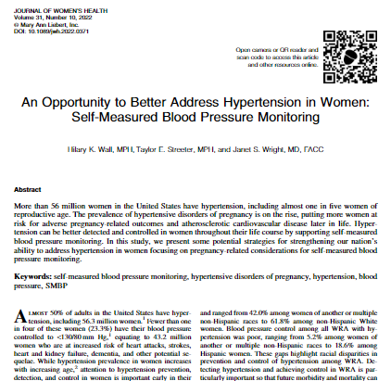
An Opportunity to Better Address Hypertension in Women – SMBP
Explores:
The need for more SMBP devices specifically validated in pregnant populations
Importance of properly sized blood pressure cuffs in pregnancy
SMBP coverage and reimbursement
Pregnant women with hypertension are hiding in plain sight
Need to leverage clinical quality measures to drive BP improvements
Wall HK, et al. J Womens Health. 2022 Sep 26. doi: 10.1089/jwh.2022.0371. Online ahead of print.

Slide 14
Devices Validated in Pregnant Populations
Blood volume increases by 40%–50% during pregnancy
Pregnancy not denoted on the U.S. Validated Device Listing (VDL)
Ghazi L, Bello NA. Hypertension in Women Across the Lifespan. Curr Atheroscler Rep. 2021;23(8):43. (Table 3)

Slide 15
Devices Validated in Pregnant Populations
Blood volume increases by 40%–50% during pregnancy
Pregnancy not denoted on the U.S. Validated Device Listing (VDL)
Ghazi L, Bello NA. Hypertension in Women Across the Lifespan. Curr Atheroscler Rep. 2021;23(8):43. (Table 3)
On the VDL:
Microlife Watch BP Home
Omron HEM-9210T

Slide 16
Properly-Sized Cuffs
2015-2020 NHANES data:
In women of reproductive age (i.e., 20–39 years), 33.5% had an arm circumference that called for a size large or extra-large cuff.
Among WRA with HTN – 53.3%
47% of women gain more than the recommended amount (i.e., 5-18kg) of weight during pregnancy
Future analysis of pregnant women arm circumferences
Jackson SL, Gillespie C, Shimbo D, Rakotz M, Wall HK. Blood Pressure Cuff Sizes for Adults in the United States: National Health and Nutrition Examination Survey, 2015-2020 [published online ahead of print, 2022 Sep 6]. Am J Hypertens. 2022;hpac104. doi:10.1093/ajh/hpac104
Notes:
blood pressure measured with a smaller-than-recommended cuff may result in higher blood pressure readings, on average, by 4.8mm Hg

Slide 17
Pregnant Women “Hiding in Plain Sight” (HIPS)
Kaiser Permanente SC, WA, NC – ~570K pregnancies (2005-2014)
Identified pregnant women with HTN:
≥2 high BPs (≥ 140/90 mmHg) w/in 30 days (High BP);
An antihypertensive fill before pregnancy and a diagnosis from 1 year prior to pregnancy through 20 weeks gestation (Treated Chronic Hypertension)
A high BP, a hypertension diagnosis, and a prescription fill within 7 days during pregnancy (Rapid Treatment)
27,049 (4.8%) met the HTN case definition
Case Definition
Chen L. Pregnancy Hypertens. 2020;19:112-118.

Slide 18
HIPS in Pregnant Women (cont’d)
Of hypertensive pregnancies:
72% received a diagnosis
41.5% had a BP ≥ 160/110
36.1% received treatment
28% of women identified as hypertensive would have been missed by using diagnosis codes alone
76.5% had ≥3 separate visits with recorded high BP
Only 7.7% treated
20.3% had ≥ 1 severe high BP
Chen L. Pregnancy Hypertens. 2020;19:112-118.
Notes:
GE 160/110 = “severe hypertension”
28% of women identified as HTN never received a diagnosis code.
87% rec’d tx (diagnosis) vs. 38% (elevated BPs)

Slide 19
Questions?
Hilary Wall – hwall@cdc.gov
https://millionhearts.hhs.gov/

Slide 20
SMBP in Action
Kameelah Phillips, MD NCMP IBCLC
Calla Women's Health
@drkameelahsays

Slide 21
Early Assessement
Identification of Risk Factors at OB Intake
Ethnicity
Kidney disease.
Diabetes
Hypertension in previous pregnancy
Obesity
Extremes of age
Multiple Gestation
IVF
Any risk factor is a trigger for MFM and Cardiology consult

Slide 22
Early Education
Setting expectations for Health
Companion at each visit
To help educate patient and family
To serve as informed advocate
Plain language communication
Limit medical jargon
"Homework" at each visit
Blood pressure
Weight management
Activity plan

Slide 23
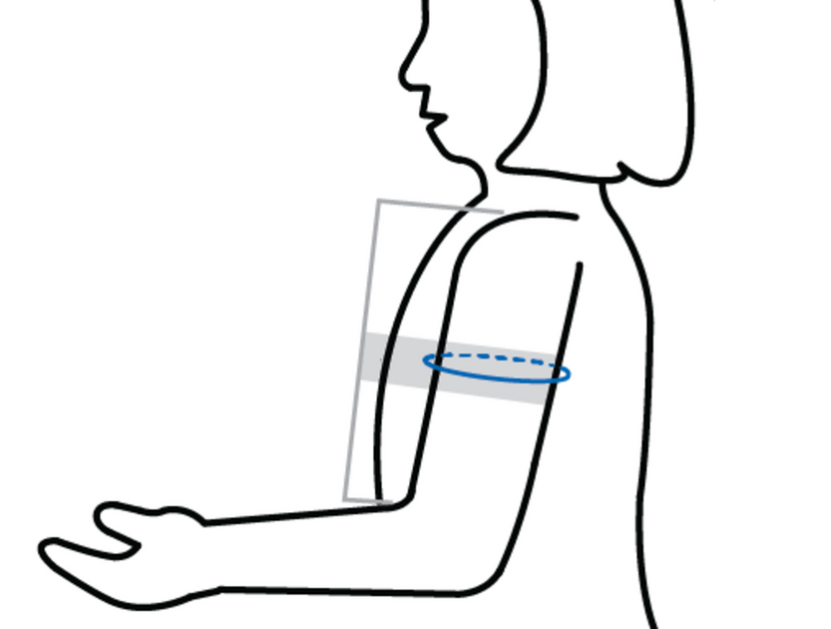
Early Education
Setting expectations for Health
Delivery Plans reviewed upfront
Review induction starting at 37 weeks
Blood pressure instruction
The Why is key
When, Where, How
Low Tech

Slide 24
Early Intervention
Setting expectations for Health
Coordination of Care begins early
Cardiology ( EKG, ECHO, BP management)
Maternal Fetal Medicine
Endocrinology and other subspecialties
Clear Goals
Early and aggressive blood pressure management
Compliance with...
Aspirin
Medications
Labor Induction

Slide 25
An OB Wish List
Improved insurance coverage for all
Pre-conception visit prior to pregnancy
Access to blood pressure cuffs
Access to Nutrition services and clean food
Access to Fitness counselor and gym
Routine VNS postpartum for BP evaluation and newborn care
Evidence based text, social media communication

Slide 26
Thank You
Kameelah Phillips, MD
@drkameelahsays

Slide 27
Community Needs & Hypertension in Pregnancy
Lisa Green, DO, MPH
CEO & Co-Founder

Slide 28
Maternal Health
Statement of Population
Maternal Mortality is at an alarming rate in Illinois. From 2008-to 2016, an average of 73 women died each year within one year of pregnancy. Black women in Illinois are 6 times more likely to die of a pregnancy-related condition than their non-Hispanic White counterparts, (IDPH, 2021).
Underserved Community
Maternity Health Desert/Food Desert
78% on Public Assistance and Snap
African American Mortality rate is 44% higher than the State
Hypertension during pregnancy has increased by 43%
Purpose
Self-Measured Blood Pressure of Hypertension
focus on a measure that could decrease complications, decrease maternal mortality, and can be measured by the health center.

Slide 29
MAP-IT
Asses
Framework
Mobilize partners.
Assess the needs of your community.
Create and implement a plan
Track your community’s progress, (HP, 2020).
Step By Step Approach allowed me to evaluate my health Intervention on a small scale.
Speak to key stakeholders
Develop questions to ask:
After reviewing the data what stands out to you?
What is important to the community?
How can you use this data to make a difference?
Data Collection from multiple sources
Determine what can be measured and changed
Create a team to discuss a mutually agreed-upon plan
Monitor the change using the problem-solving model PDSA (Plan, Do, Study Act)
Implement & Track measurable SMART goals

Slide 30
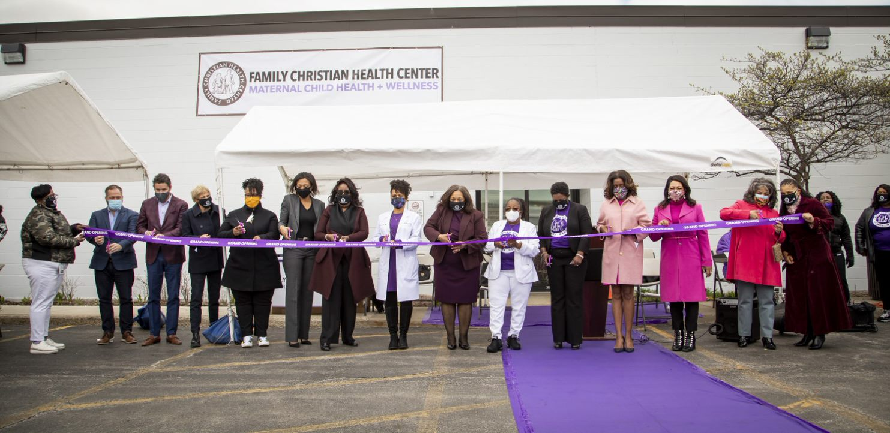
“The way to get started is to quit talking and begin doing.”
As a result of Dr. Green leading a discussion and hosting an accountability event called, “Breaking Silos & Taking Action” Opened a new Maternal Child Health + Wellness Center and advocated for all women in the State of Illinois who are part of a Managed Care Plan are eligible for a blood pressure monitor at the first OB visit.
Any pregnant women with an elevated blood pressure will be offered to be placed in a remote bp monitoring program.
Intervention/Self-Measured Blood Pressure Monitoring for Pregnant Women with Hypertension plus FREE grocery bag
Walt Disney

Slide 31
Timeline
Team decision to Self-Measured Blood Pressure program to OB. Pilot Implementation Started 4/12/2022
Success in implementing programs on small scale and using the PDSA model
Quality will track Data Monthly and manage the PDSA rollout
APN Students will help register patients
User Guide Created BP Setup Guide.pdf
Grocery Bags’ weekly preliminary pilot started in March 2022
Monthly Farmers Market scheduled from May through Oct.
Pilot approved by Quality
BP units delivered to OB
Providers & Staff Educated on the process
APN Students will help register patients
Supervisor will notify primary care when additional units are needed.
Case management will manage Grocery Bags deliveries and track data
Monthly Farmers Market scheduled from May through Oct. Data will be tracked
April 2022
March 2022
May - October 2022

Slide 32
Quality and Goals
Elevated BP 140/90
Quality Team
All OB Patients with elevated BP offered to participate(Tertiary Prevention)
80% will record a daily BP and upload it to the app up to 6 weeks postpartum
80% will receive a weekly bag of groceries
65% will have a BP lower than 140/90 after being educated on hypertension
Grocery Bag Weekly
Cont.
Run Data monthly from the Electronic Health record
Discuss Hypertension data monthly with the multidisciplinary team
Report the key metric finding to the team/CEO and Board
10% improvement in hypertension control
African American complications ratio decreased from 41 to 28 the HP2020 goal
Maternal Death rate decreased from 32 to 11

Slide 33
Program Offering
OB Intake
OB Intake Alternative Plan
Vital Signs at every visit (Secondary prevention)
BP is 140/90 or higher
Can be offered at 130/80 as well but not included in the metric measured
Expecting mother is offered to be started in the FREE Self-Measured Blood Pressure program
All offered free grocery bags weekly. A healthy diet has shown improvement in progressing to hypertension/diabetes and other chronic health conditions per the CDC. (Primary prevention).
Yes-Education on the process begins with a unit included for free
iPhone or Android phone-download app and pair with BP unit See guide
Education on what is hypertension and steps on how to control and manage to prevent progression. Resources
Follow up visit scheduled
In between visit calls set up
Vital Signs Completed
BP is 140/90 or higher
Expecting mother is offered to be started in the Self-Measured Blood Pressure program
No-Education provided and given an option to do home blood pressures not connected to an app.
Resources on Hypertension
Follow up visits more frequent
Calls to get BP readings
Grocery bag Weekly
Notes:
(These don’t have designer IDs since they were based off the default master slides already in the deck.

Slide 34
Thank You Reference available upon request

Slide 35
Q&A and Open Discussion
Notes:
Meg – Ask the top three questions from the presentations here

Slide 36
Discussion Panelist
Moderator: Meg Meador (NACHC)
Hilary Wall (CDC)
Dr. Kameelah Phillips (Calla Women’s Health)
Dr. Lisa Green (Family Christian Health Center)
Dr. Evelina Grayver (Northwell Health)
Eleni Tsigas (Preeclampsia Foundation)
Dr. Colleen Harrington (Massachusetts General Hospital/Massachusetts ACC)
Dr. Natalie Bello (Cedars Sinai)
Fatmata Williams (Connecticut Medicaid)
Bernadette D’Almeida (Community Health Network of Connecticut)
Aisha Syeda (American Hospital Association)

Slide 37
Discussion Questions + Questions from the Chat
When caring for pregnant/postpartum women using SMBP, what are some best practices/solutions that have worked well for your organization?
Nationally, what can be done to support and enhance the implementation of SMBP for pregnant and postpartum women?

Slide 38
Clinical Quality Measure Gap
Screening for High Blood Pressure and Follow-Up Documented (CMS22)
Controlling High BP
(CMS165/NQF 0018)
Measurement Gap
Excludes Pregnant People
Includes Pregnant People
% of patients 18-85 years of age who had a diagnosis of HTN overlapping the measurement period or the year prior to the measurement period, and whose most recent blood pressure was adequately controlled (<140/90mmHg) during the measurement period.
% of patients aged 18 years and older seen during the reporting period who were screened for high blood pressure AND a recommended follow-up plan is documented based on the current BP reading as indicated
BP Control Among Pregnant People
Notes:
Hilary – share as needed

Slide 39
Updates
Notes:
Rita

Slide 40
The Heart Truth®
Brittany R. Royall, MS, CHES, PMP
December 8, 2022

Slide 41
Educational Resources
Notes:
Help support Self-Measured Blood Pressure (SMBP) monitoring efforts

Slide 42
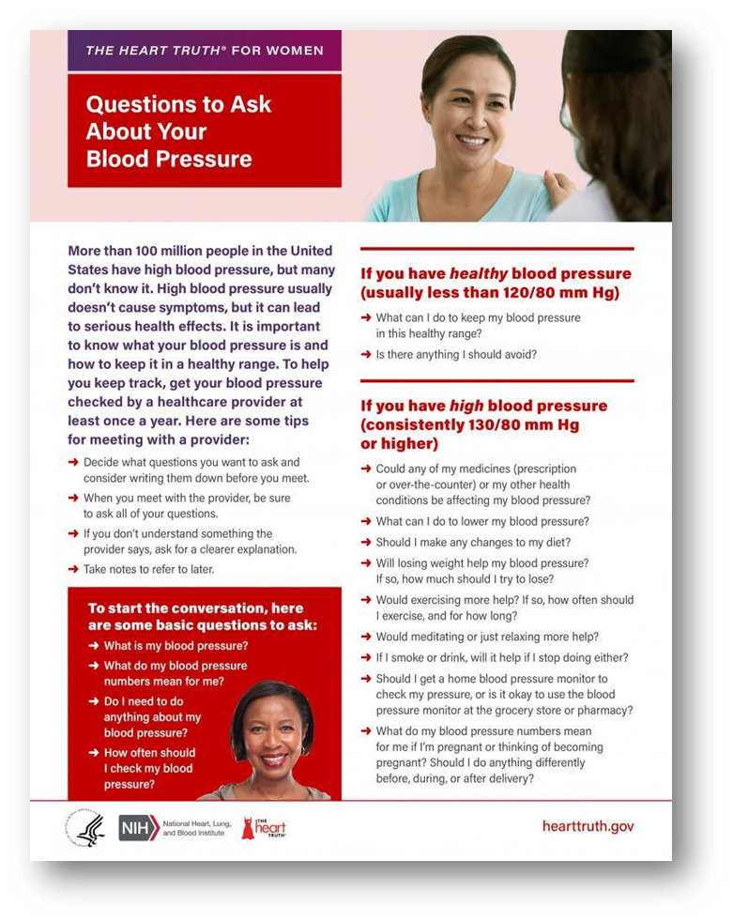
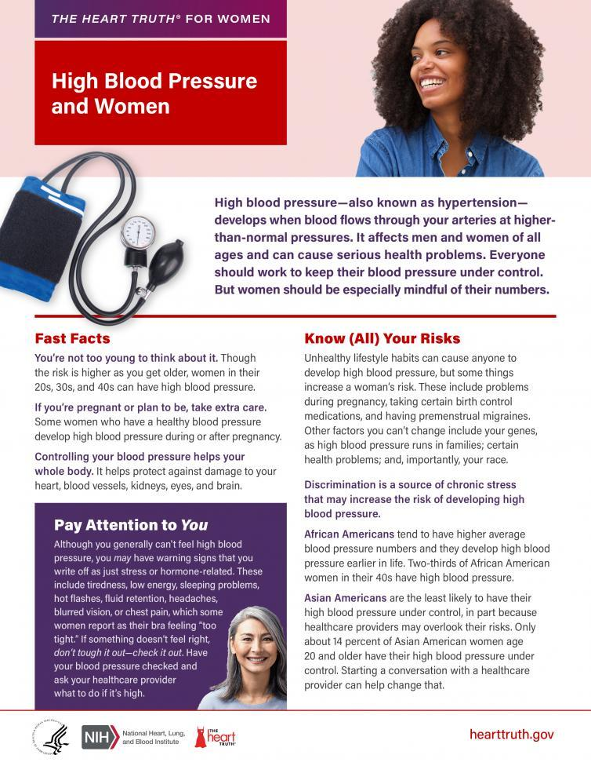
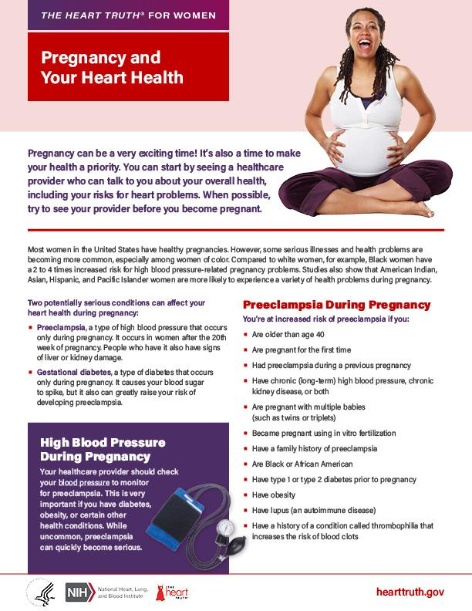
Fact Sheets
Fact sheets
High Blood Pressure and Women
Questions to Ask About Your Blood Pressure
Available in English & Spanish
Notes:
Fact sheets:
High Blood Pressure & Women
Questions to Ask About Your Blood Pressure
Pregnancy & Your Heart Health
All include tips to accurately measure your blood pressure
Available in English & Spanish; download or order free print copies.

Slide 43
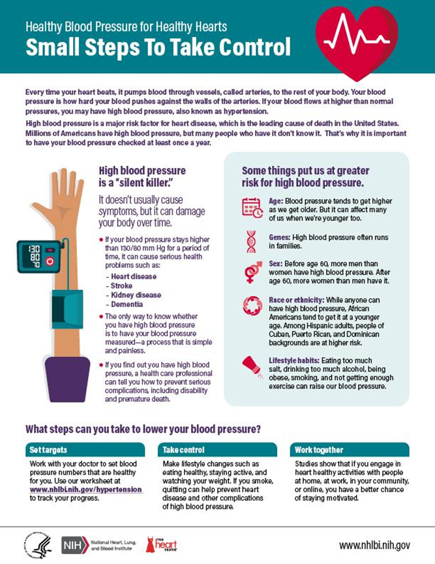
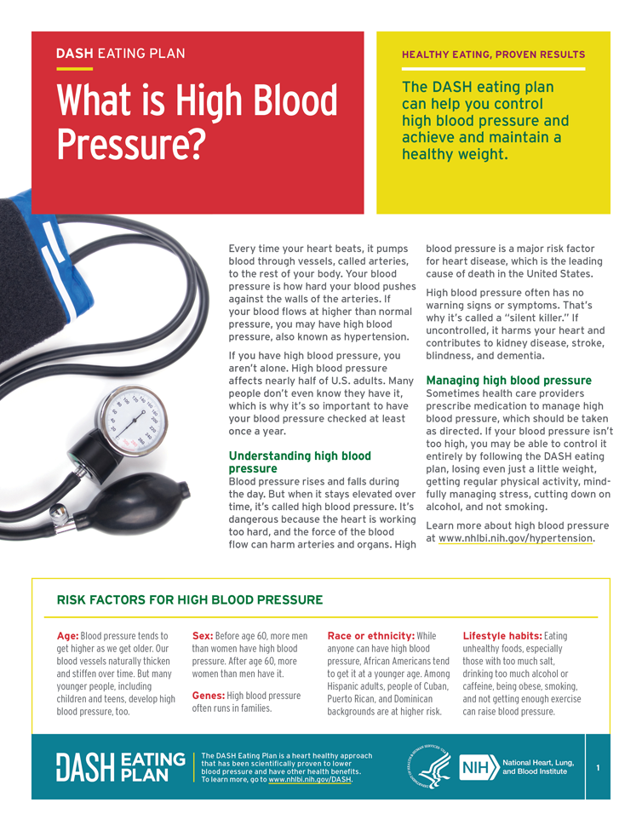
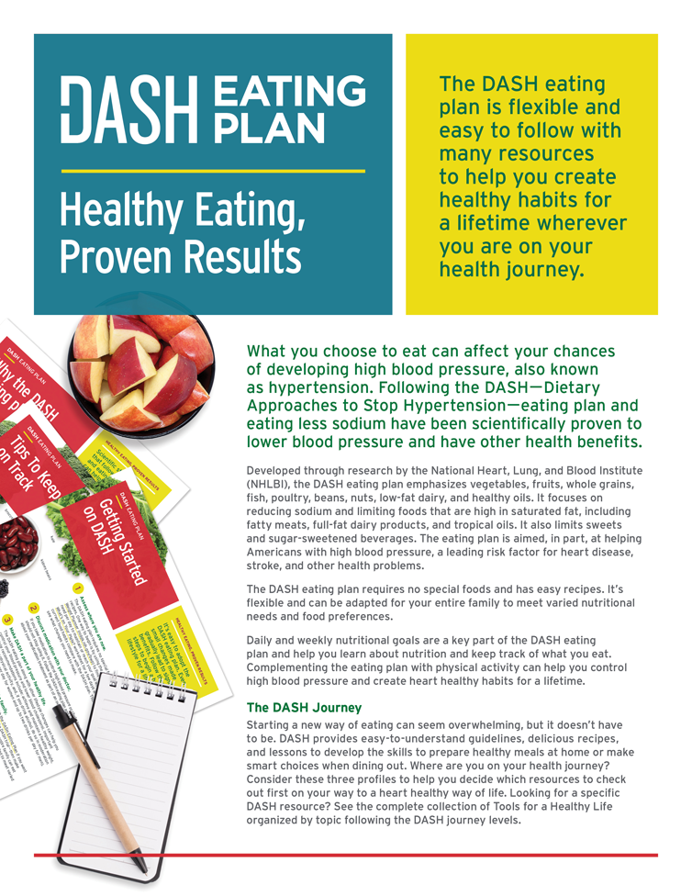
Fact Sheets
Notes:
Fact sheets:
General high blood pressure & tips to accurately measure your blood pressure fact sheets:
What is High Blood Pressure?
Small Steps to Take Control
DASH (Dietary Approaches to Stop Hypertension) eating plan facts sheet & resources
Many available in English & Spanish; download or order free print copies.

Slide 44
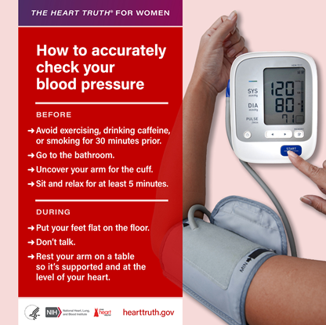
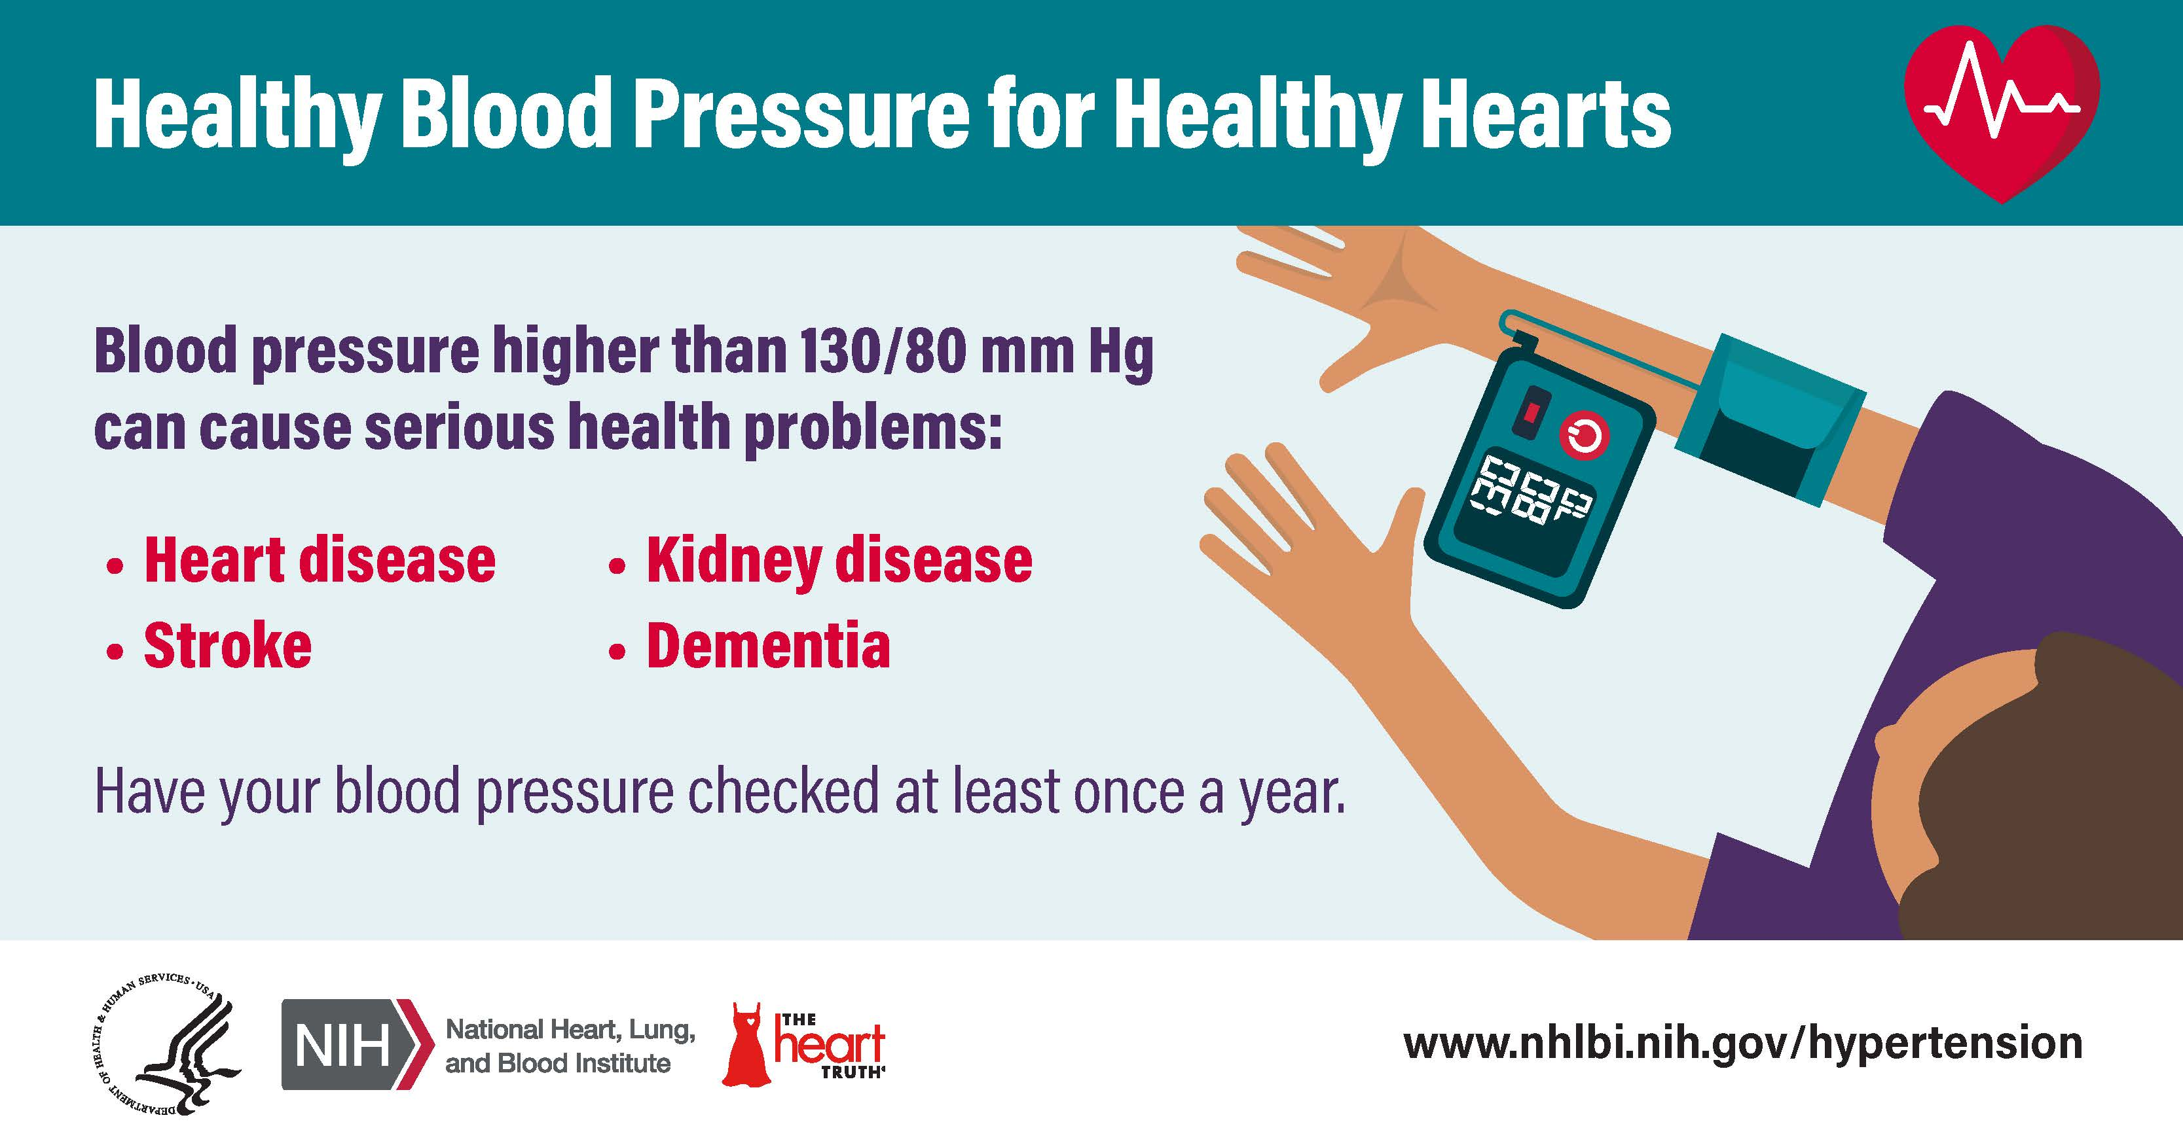
Social Media Resources
Notes:
Social Media Resources
Social media graphics & GIFs:
Population Specific: women & those higher at risk for high blood pressure
General blood pressure graphics
GIFs featuring our heart character
Tips to accurately measure your blood pressure – Also included in fact sheet

Slide 45
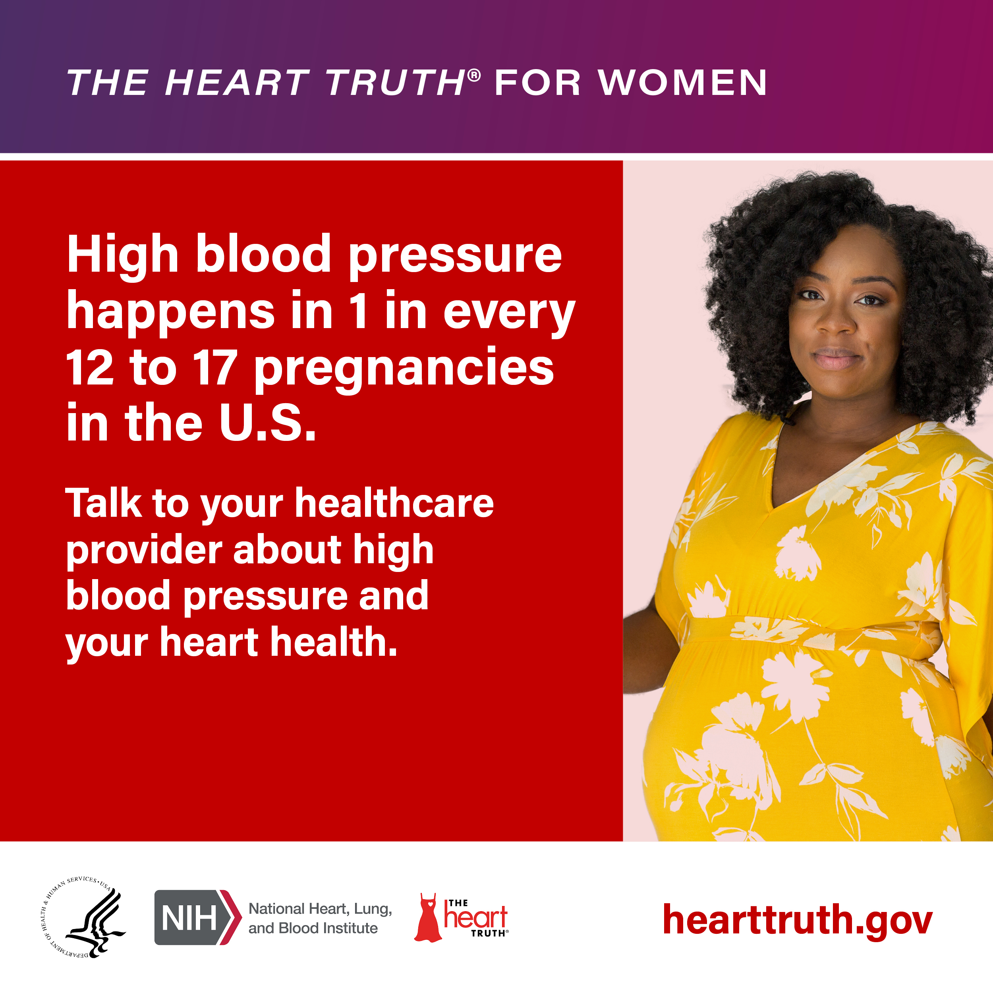
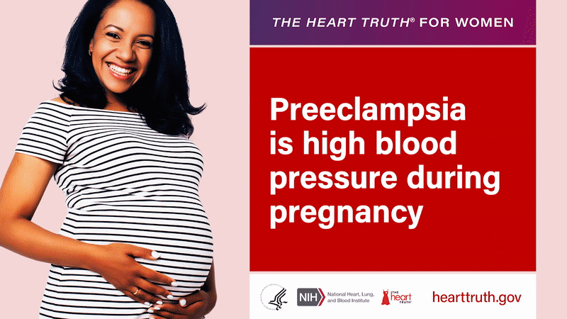
Social Media Resources
Notes:
Social Media Resources
Social media graphics & GIFs:
High blood pressure during pregnancy
Heart-healthy pregnancy registry: Encouraging you to practice self-care for your heart and control your blood pressure before, during, and after pregnancy.

Slide 46
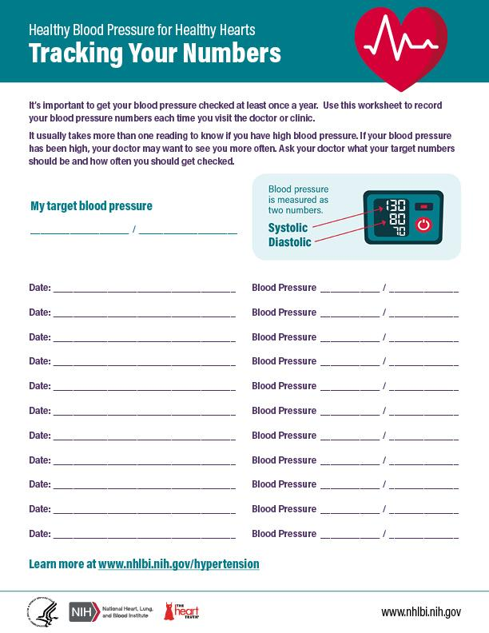
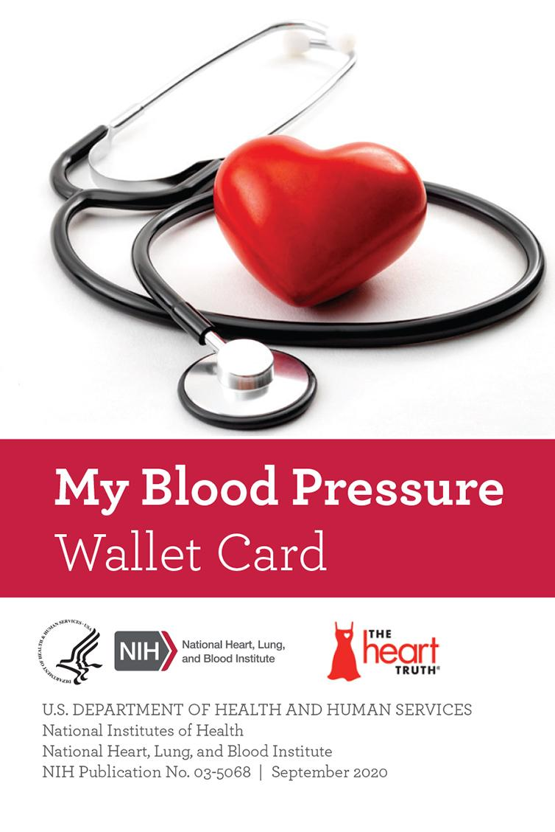
Blood Pressure Tracking Resources
Notes:
Ways to track your blood pressure:
My Blood Pressure Wallet Card
Tracking your numbers fact sheet
Available in English & Spanish; download or order free print copies.

Slide 47
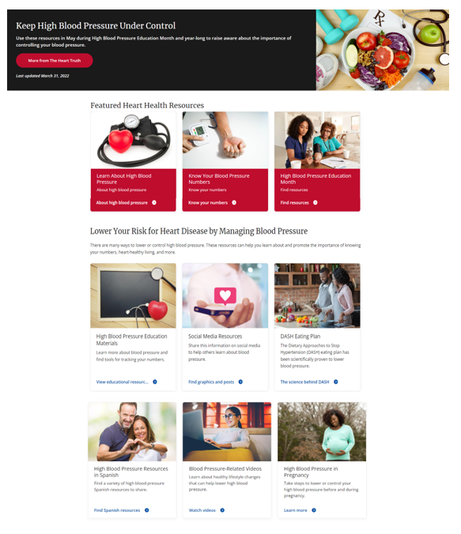
Visit The Heart Truth
nhlbi.nih.gov/hypertension
Resources include:
Fact sheets
Spanish resources
Social Media graphics & sample content
DASH eating plan resources
High blood pressure & pregnancy resources
And more!
Notes:
Find additional resources at nhlbi.nih.gov/hypertension

Slide 48
Thank you!
Questions? HealthEdu@nhlbi.nih.gov
NHLBI Publications and Resources
Order materials from the NHLBI Center for Health Information
Phone: 1-877-NHLBI4U (1-877-645-2448)
Email: NHLBIinfo@nhlbi.nih.gov
Live Chat
Like and follow us on social media. Tag us in your posts and use #OurHearts!
facebook.com/hearttruth
twitter.com/thehearttruth
pinterest.com/thehearttruth
instagram.com/thehearttruth_nhlbi/

Slide 49
The Cuff Kit™ Project
June 2020-ongoing

Slide 50
Project Goals & Benefits
Complimentary validated-in-pregnancy BP devices* with Bluetooth technology, patient education material, and participation in research studies
Empower patients to recognize and report preeclampsia symptoms and signs
Educate patients and their families on SMBP for pregnancy and a lifetime of health monitoring and management
Reduce noted disparities and COVID-19 effects
Support healthcare providers in outpatient Monitoring and Management of BP (3 Ms)
Collect data to demonstrate efficacy and cost effectiveness
User experience with SMBP (patients and providers)
SMBP effect on patient care and BP management
SMBP effect on pregnancy and postpartum health outcomes
SMBP effect on health disparities
Health economics of SMBP
Help build the case for payor coverage and institutional changes around SMBP
*See www.strideBP.org for list of validated devices
© 2022 Preeclampsia Foundation

Slide 51
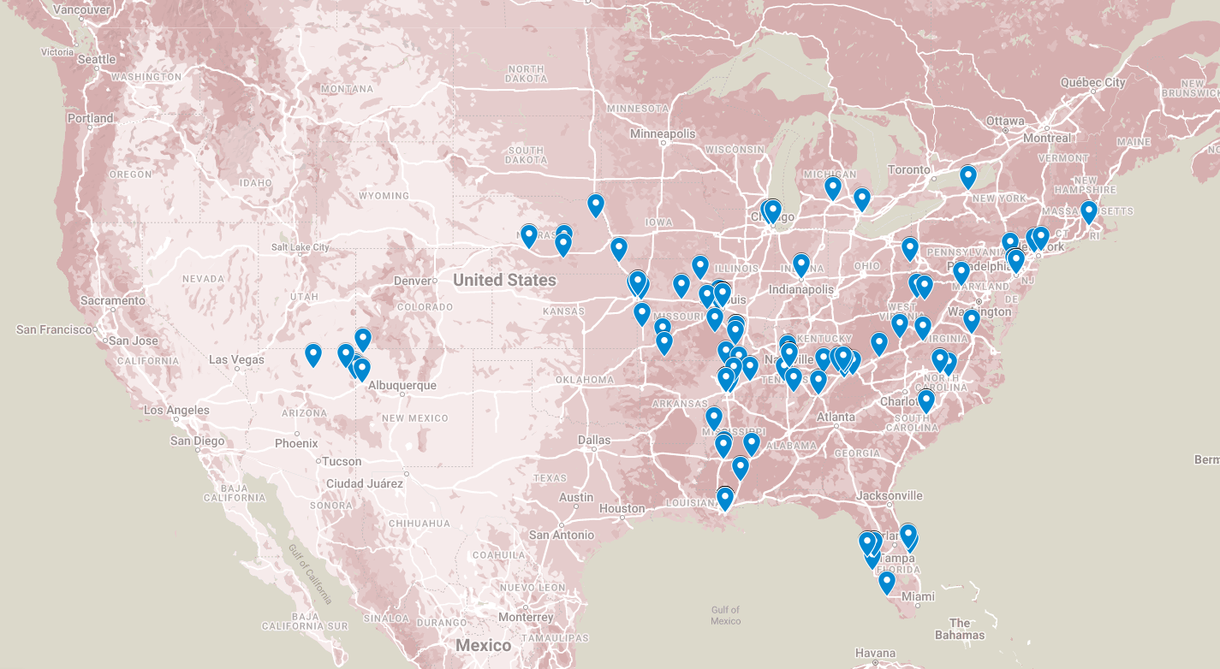
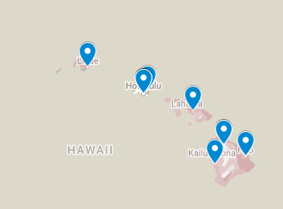
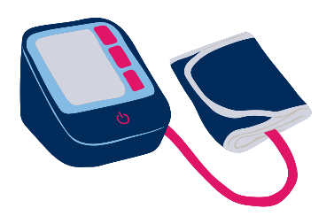
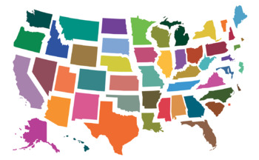
Distribution to Highest Risk Patients:
Chronic HTN
Previous history of PE
Obesity (BMI 30+)
Age (35+)
Autoimmune disorders
Black/African-American
Native American/Alaska Native
Rural
16,126
191
21
Total cuffs shipped: 16,126
Providers distributed to: 191
States distributed to: 21
Data collected thru October 2022
© 2022 Preeclampsia Foundation

Slide 52
Cuff Kit Recipients by Race
N=2392
© 2022 Preeclampsia Foundation

Slide 53
Cuff Kit Recipients by Gestation
1st
Trimester
(12%)
Postpartum
(30%)
2nd
Trimester
(26%)
3rd Trimester
(31%)
Post-
Partum
(37%)
N=2392
© 2022 Preeclampsia Foundation

Slide 54
Providers perception of how the Cuff Kit has influenced patient’s care
Didn’t Answer
10%
Did Not Influence
7%
Significantly Influenced
49%
Significantly Influenced
47%
Somewhat Influenced
35%
Somewhat Influenced
36%
N=72 sites
N=2,392 patients
© 2022 Preeclampsia Foundation

Slide 55
How valuable was being able to take your BP at home to you? (patients reporting)
Save as
Customize
Didn’t Answer
(10%)
Valuable
(22%)
Valuable
Very Valuable
(68%)
N=80 patients
© 2022 Preeclampsia Foundation

Slide 56
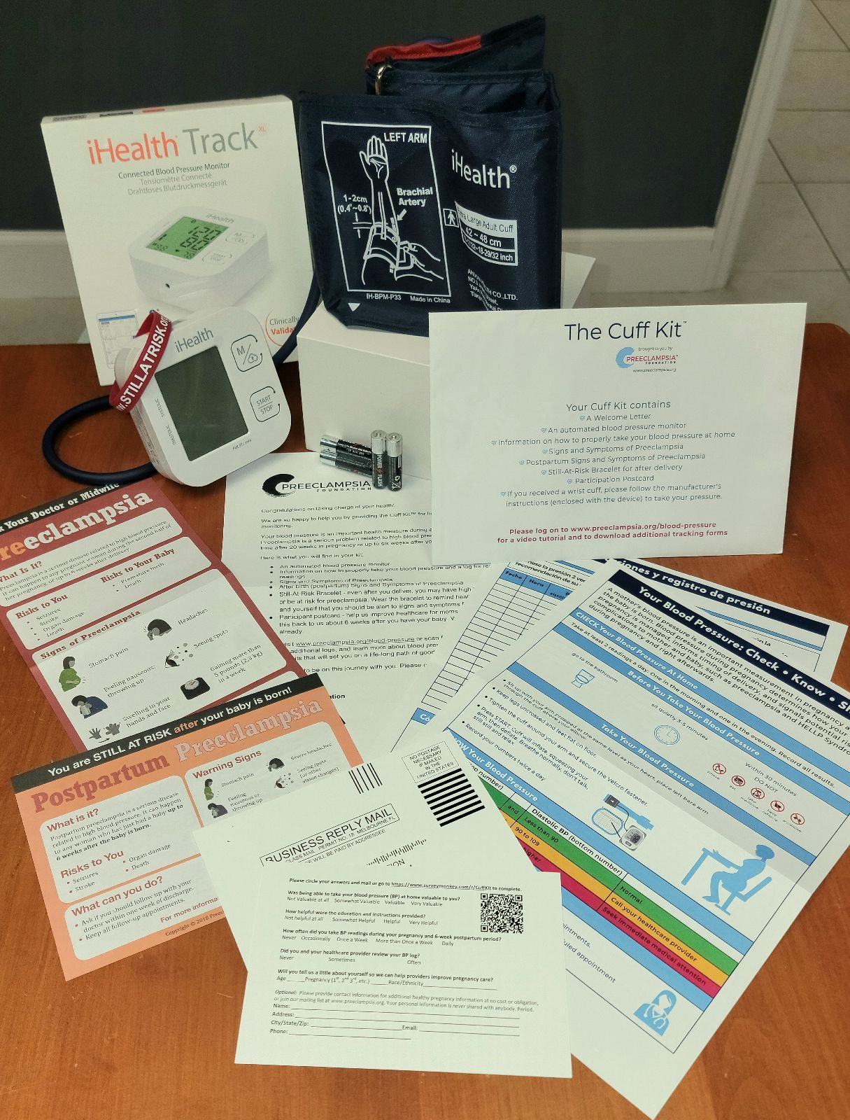
Cuff Kit Contents
BP Monitor & Batteries (Bluetooth)
Instructions including link to online video and website
Information and tracking Log
Signs and symptoms education
Postpartum preeclampsia information
Preeclampsia signs and symptoms magnet
“Still at Risk” rubber bracelet
Participants feedback postcard
© 2020 Preeclampsia Foundation

Slide 57
Patient Education
Review Contents: Welcome Letter, Signs and Symptoms, Participant postcard, Wristband, Logs, Monitor, and Cuff
Demonstrate how to take proper blood pressure
Review mechanisms for how to record/log patient BP
Have patient demonstrate proper use
Use “teach back” to ensure understanding of all contents and their uses

Slide 58
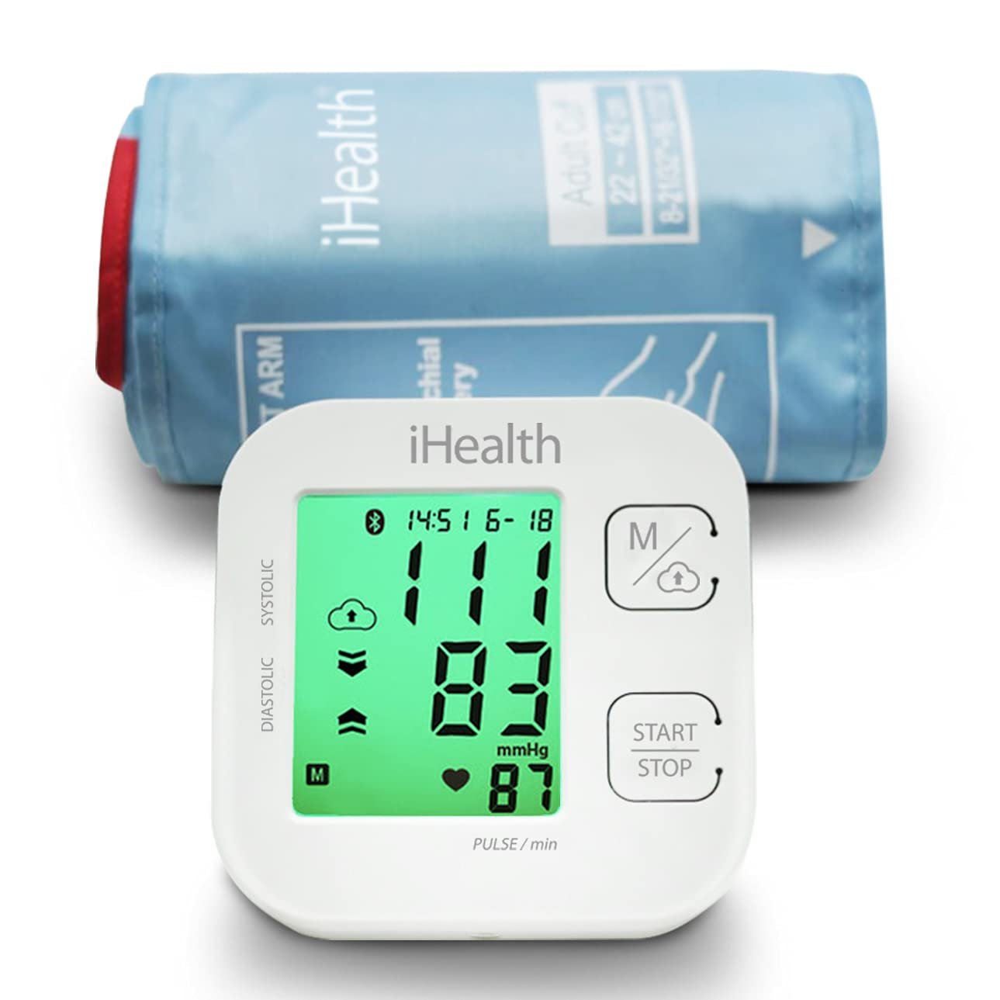
Automated blood pressure monitor/cuff with batteries
Validated in Pregnancy
© 2022 Preeclampsia Foundation

Slide 59
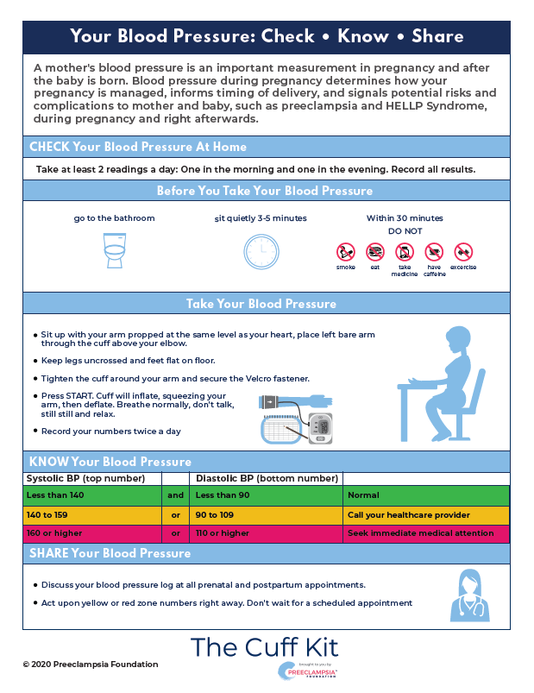
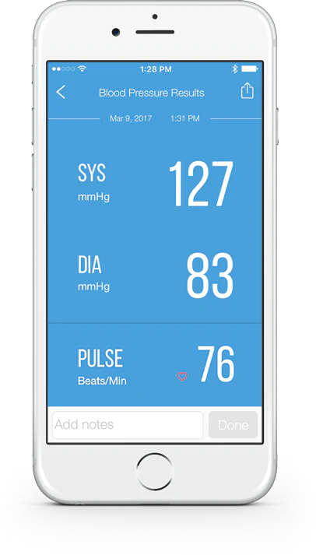
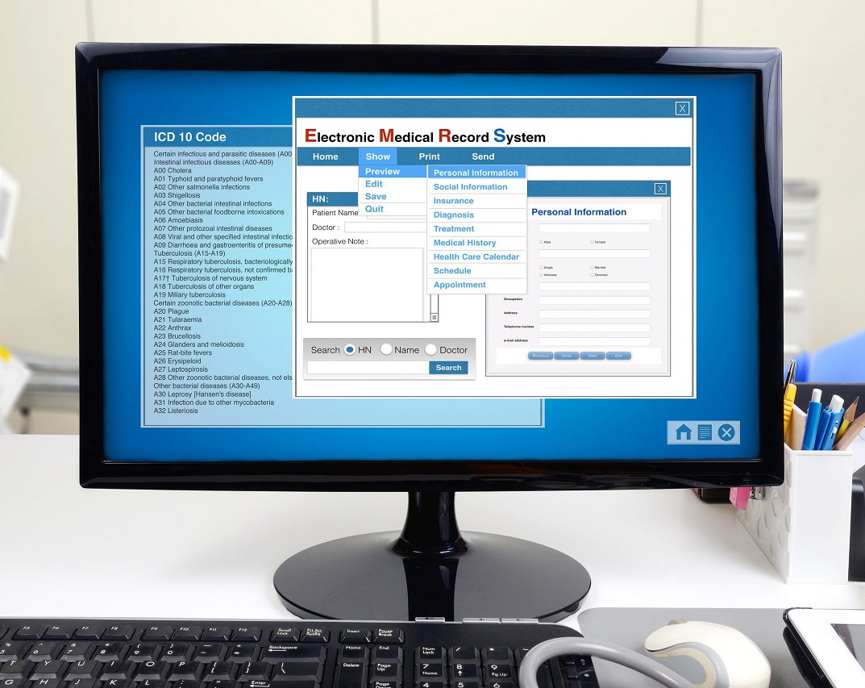
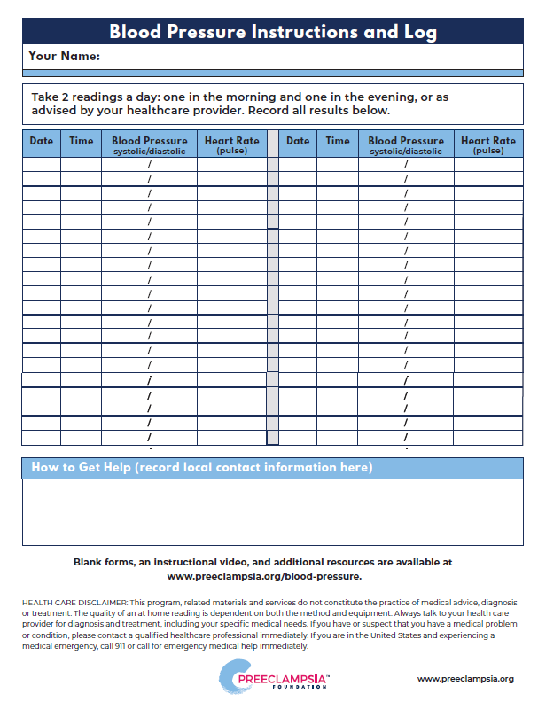
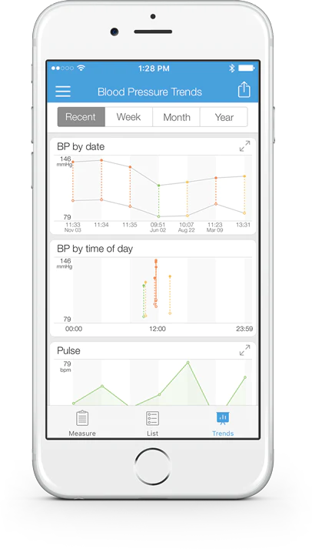
Multiple Channels to BP Reporting
Coming Soon
EMR Integration (e.g., Epic)
Bluetooth Applications
iHealth app
Paper Logs
© 2020 Preeclampsia Foundation

Slide 60
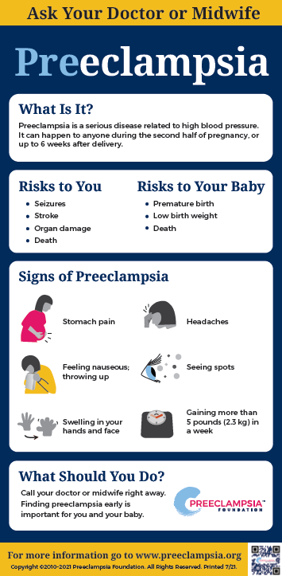
Preeclampsia and
Postpartum Preeclampsia Signs & Symptoms
© 2022 Preeclampsia Foundation

Slide 61
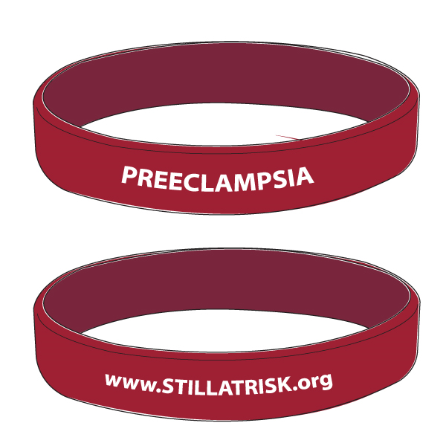
Preeclampsia
“Still at Risk” Wristband
© 2022 Preeclampsia Foundation

Slide 62
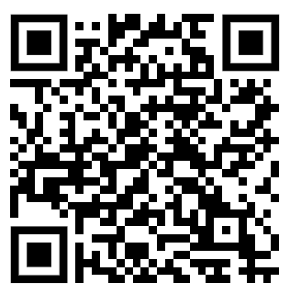
More info here
© 2022 Preeclampsia Foundation

Slide 63
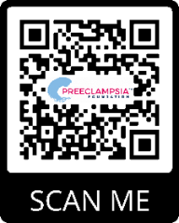
Additional Resources
Monthly Cuff Kit Connection Meetings (technical assistance, office hours) for all participating sites and providers
Data sharing, including provider-reported information and patient-reported information
All fulfillment and distribution to any state and US territories
More info: www.preeclampsia.org/the-cuff-project
Email: cuffkit@preeclampsia.org
© 2022 Preeclampsia Foundation

Slide 64
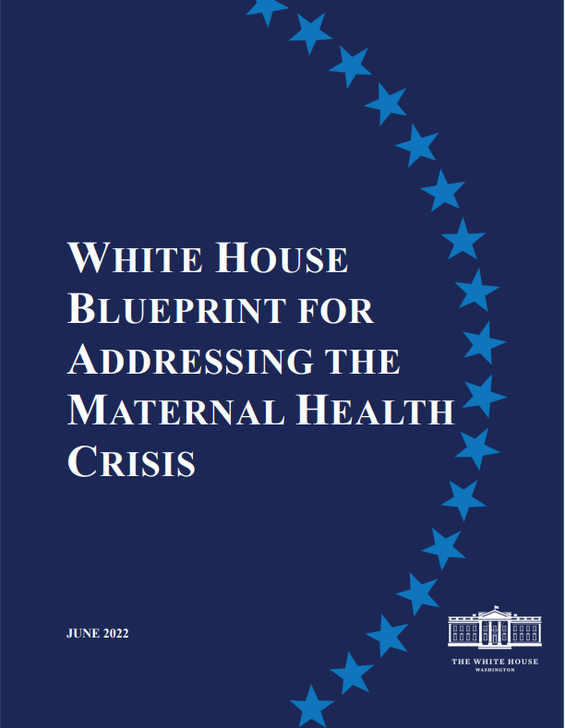
Federal Plans to Address Maternal Health
Healthy Women, Healthy Pregnancies, Healthy Futures: Action Plan to Improve Maternal Health In America
Surgeon General’s Call to Action to Improve Maternal Health
White House Blueprint for Addressing the Maternal Health Crisis
Notes:
The federal government recently released several plans to address maternal health in the United States, and all plans call attention to or include recommendations for addressing hypertension in women of reproductive age.
In 2020, HHS released Healthy Women, Healthy Pregnancies, Healthy Futures: Action Plan to Improve Maternal Health In America. A key target included in this action plan for reducing maternal mortality is achieving blood pressure control in 80% of women of reproductive age with hypertension in 5 years.
In 2020, the Surgeon General also released a Call to Action to Improve Maternal Health. This call to action acknowledges the risk of hypertensive disorders of pregnancy on maternal and fetal outcomes and recommends including a history of hypertensive disorders of pregnancy in cardiovascular risk evaluations.
In 2022, the White House released the Blueprint for Addressing the Maternal Health Crisis. This blueprint recommends self-measured blood pressure monitoring tools and resources for obstetrical providers, primary care professionals, and the pregnant and postpartum women they serve.

Slide 65
Select Federal Initiatives to Address BP Control in Women
Date | Federal Initiative
2008-Present | CDC’s WISEWOMAN program in 21 states and 3 tribal organizations
February 2019 | HRSA Challenge spotlighted experts in remote health monitoring, including SMBP during and following pregnancy
December 2020 | HHS Healthy Women, Healthy Pregnancies, Healthy Futures: Action Plan to Improve Maternal Health In America One of 3 targets is 80% control in 5 years among WRA with HTN
December 2020 | Surgeon General’s Call to Action to Improve Maternal Health acknowledges the harm of undetected and uncontrolled hypertension
October 2021 | HHS OWH launched the annual National Women’s BP Awareness Week and the SMBP Partnership Program to accelerate update among women
January 2022 | Million Hearts® embeds a focus on SMBP use in pregnant and postpartum women with hypertension for 2022-2026
June 2022 | White House Blueprint For Addressing The Maternal Health Crisis calls for SMBP for pregnant and postpartum women with or at risk for HDP. Major commitments from the Indian Health Service, Office of Personnel Management and the Veterans’ Administration
HRSA = Health Resources and Services Administration; HHS = Department of Health and Human Services; WRA = Women of Reproductive Age; OWH = Office of Women’s Health
Notes:
In addition to the federal plans specifically on maternal health, there are also many federal initiatives focused on blood control in women. This includes
CDC’s WISEWOMAN program that seeks to help women understand and reduce their risk for heart disease and stroke by providing services to promote lasting heart-healthy lifestyles.
HRSA’s challenge that spotlighted SMBP during and following pregnancy
The Office of Women’s Health has an annual National Women’s BP Awareness Week and the SMBP Partnership program
Million Hearts 2027 embeds a focus on SMBP use in pregnant and postpartum women with hypertension

Slide 66
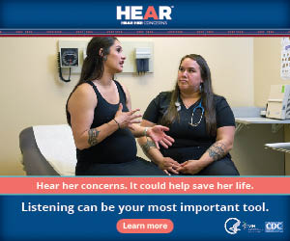
CDC’s Hear Her Campaign Resources
Website in English and Spanish
Microsites and content syndication
Video testimonials
Printable resources (some in more than 20 languages)
Conversation guides
Palm cards
Urgent maternal warning signs poster
Digital graphics/ media ads
Social media toolkit
Hear Her Facebook Page
Public Service Announcements
English and Spanish (:30 secs)
Matte Articles
Notes:
Many of you are likely familiar with CDC’s Hear Her campaign, a national effort to address maternal mortality in the United States. The campaign seeks to
Raise awareness of urgent maternal warning signs during and within the year after pregnancy
Encourage support systems and healthcare professionals of pregnant and postpartum people to really listen when they express concerns
Presented here are resources available for consumers and healthcare professionals that feature urgent maternal warning signs and tips for talking about concerns with healthcare providers
In November 2022, CDC also released materials designed specifically for American Indian/ Alaska Native communities since this population is disproportionately affected by pregnancy-related death.
You can reach out to HearHer@cdc.gov to be connected with the Hear Her campaign.
Additional Notes from DRH if needed
The Hear Her website is available in English and Spanish. You can incorporate Hear Her content on your websites as an English or Spanish microsite or through content syndication. As information is updated on CDC’s website, it will automatically update on your microsite.
The campaign features compelling stories from women about their experiences during or after pregnancy. They share how pregnancy-related complications or conditions have affected them and how they got help.
There are printable resources (some in more than 20 languages). There are conversation guides and palm cards for pregnant and postpartum people to learn about urgent maternal warning signs and tips for talking about concerns with their healthcare providers, and also ones for partners/husbands, friends, family, and other caregivers of pregnant and postpartum people with tips on how to listen and act quickly when they say that something doesn’t feel right.
One of the most popular materials is a poster that highlights the maternal warning signs that require medical care right away if experienced by pregnant or postpartum people. These could indicate serious pregnancy-related complications. The palm cards and this poster are also available to order at no cost through CDC-INFO.
There is a variety of graphics and sample social media posts and graphics that can be used through your organization or personal channels.

Slide 67
CDC’s Hear Her Campaign Overview
The Hear Her campaign seeks to
raise awareness of urgent maternal warning signs during and within the year after pregnancy
encourage support systems and healthcare providers of pregnant and postpartum people to really listen when they express concerns
Healthcare professionals can help patients understand the urgent maternal warning signs and when to seek medical care right away.
Urgent Maternal Warning Signs
Notes:
NOTE: This slide will not be visible during the forum. It will be shared as part full deck posted to Confluence
CDC’s Hear Her campaign is a national effort to address maternal mortality in the United States by raising awareness of urgent maternal warning signs during and within the year after pregnancy, and encouraging support systems and healthcare professionals of pregnant and postpartum people to really listen when they express concerns.
An accurate diagnosis, timely treatment and quality care can prevent many pregnancy-related deaths. Listening and taking the concerns of pregnant and recently pregnant people seriously is a simple, yet powerful action to prevent pregnant-related deaths.
Healthcare professionals who serve pregnant and postpartum people should be aware of these warning signs and educate their patients about when they need to seek immediate care.
Everyone has a role to play in supporting pregnant and postpartum people and preventing pregnancy-related deaths.

Slide 68
Upcoming Million Hearts® and Partner Events
Date/Time | Title | Host | Live Audience | Links or Contact Information
Jan 12, 2023 12:00-1:30pm ET | Million Hearts Climate Change & Cardiovascular Disease Collaborative | CDC/ OCCHE | All partners | Registration Link
Jan 18, 2023 3:00-3:45pm ET | Million Hearts Learning Lab: Motivational Interviewing for Medication Adherence | CDC/ NACHC | All partners | Registration Link Click here for information on claiming CME credits.
Notes:
Rita

Slide 69
Closing Questions or Thoughts
Any remaining questions from today’s conversation?
Suggestions for future topics?
Notes:
Judy

Slide 70
We Want to Hear From You!
Do you have resources or updates to share with the Million Hearts® SMBP Forum?
Please send information to MillionHeartsSMBP@nachc.org
Notes:
Judy

Slide 71
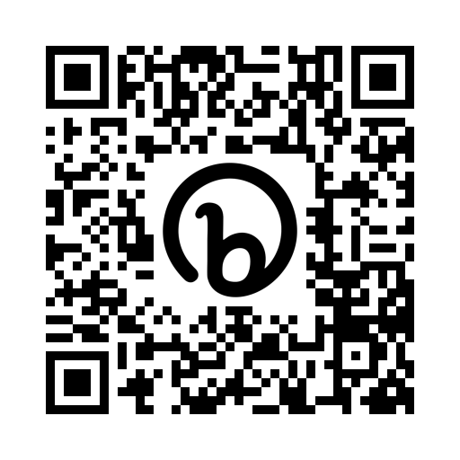
Thank You!
The next SMBP Forum to be held March 9, 2023.
Register at https://bit.ly/SMBPForumRegistration2023
Please complete the post call survey:
https://nachc.co1.qualtrics.com/jfe/form/SV_4ZrrKuz1SOGsamW
Send questions or comments to MillionHeartsSMBP@nachc.org.
Notes:
Rita

